Slide 1

DATA ANALYST CAPSTONE PROJECT
Mutual Fund Analytics
Python | SQL | Power BI | Financial Analytics
Sumit Banerjee
Data Analyst Intern
Bluestock Fintech
June 2026

Slide 2







Project Overview
Business Problem
Project Objectives
Expected Outcomes
The need for a centralized, data-driven approach to evaluate mutual fund performance, track market trends, and decode underlying investor transaction patterns.
Consolidate disparate data sources, engineer robust financial metrics, and build an interactive dashboard to empower strategic investment decisions.
A comprehensive BI dashboard providing actionable insights on fund risk-adjusted returns, SIP inflow trends, and target demographic behaviors.

Slide 3

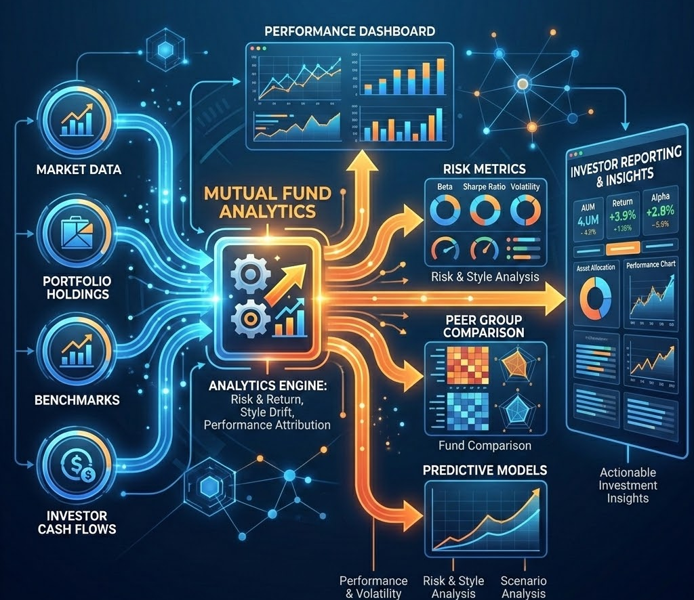
Comprehensive Data Sources
Total Sources Used: 10 Raw Datasets + MFAPI + Generated Analytics Tables
Fund Master Data: AMC details, fund categories, launch dates.
NAV History: Historical pricing data via direct MFAPI integration.
AUM Data: Asset Under Management metrics by fund house.
SIP Inflows: Monthly systematic investment tracking.
Investor Transactions: Granular purchase/redemption logs.
Portfolio Holdings: Asset allocation and sector breakdown.
Benchmark Data: NIFTY 50 and index comparative baselines.

Slide 4







Data Pipeline & Architecture
Raw CSV Files & APIs
Python ETL & Data Cleaning
SQLite Database
Analytics Engine
Power BI Dashboard
1. Extraction
2. Transformation
3. Load
4. Visualization
Gathering multiple mutual fund datasets from CSV files and APIs.
Handling missing values, standardizing dates.
Relational mapping using SQLAlchemy.
Interactive DAX measures & reporting.

Slide 5









Technology Stack
Python
Pandas & NumPy
SQLite
SQLAlchemy
Core Scripting
Data Manipulation
Data Storage
ORM Integration
Power BI
GitHub
Data Visualization
Version Control

Slide 6
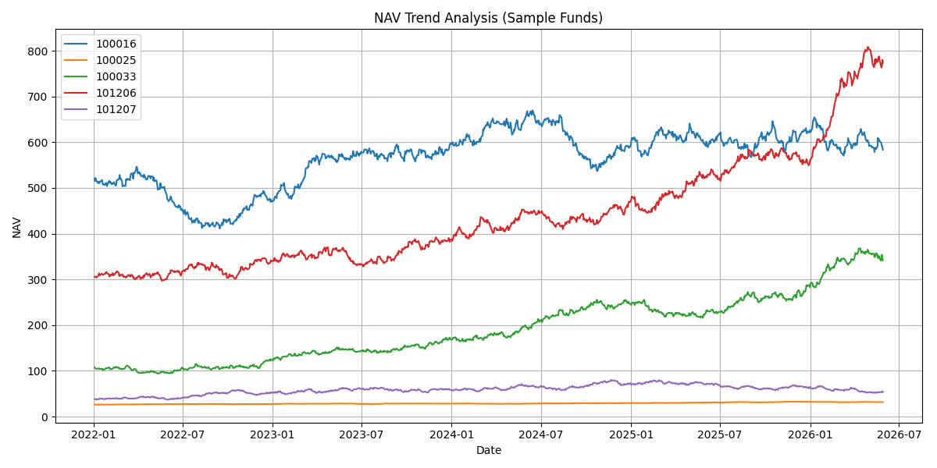
Exploratory Data Analysis (EDA)
Key Market Insights
NAV values showed a consistent upward trend across most equity-oriented funds.
Monthly SIP inflows increased steadily throughout the analysis period.
Industry AUM demonstrated strong long-term growth.
Investor transactions were concentrated across key age groups and major states.
Correlation analysis revealed varying relationships between fund categories.
NAV Trend Analysis (2022-2026)

Slide 7
Performance Analytics & Risk Metrics
Key Metrics Calculated:
• CAGR (Compound Annual Growth Rate)
• Sharpe Ratio (Risk-Adjusted Return)
• Sortino Ratio (Downside Risk-Adjusted Return)
• Alpha & Beta Analysis
• Maximum Drawdown
• Fund Scorecard Ranking
Project Highlights:
• Best Fund Score Achieved: 100
• Top Ranked Fund: AMFI 120505
• Highest Observed Sharpe Ratio: 1.09
• Highest Observed Sortino Ratio: 1.83
• Maximum Drawdown Range: -4.31% to -35.45%
Metric | Value
Highest Sharpe Ratio | 1.09
Highest Sortino Ratio | 1.83
Best Fund Score | 100
Lowest Drawdown | -4.31%

Slide 8
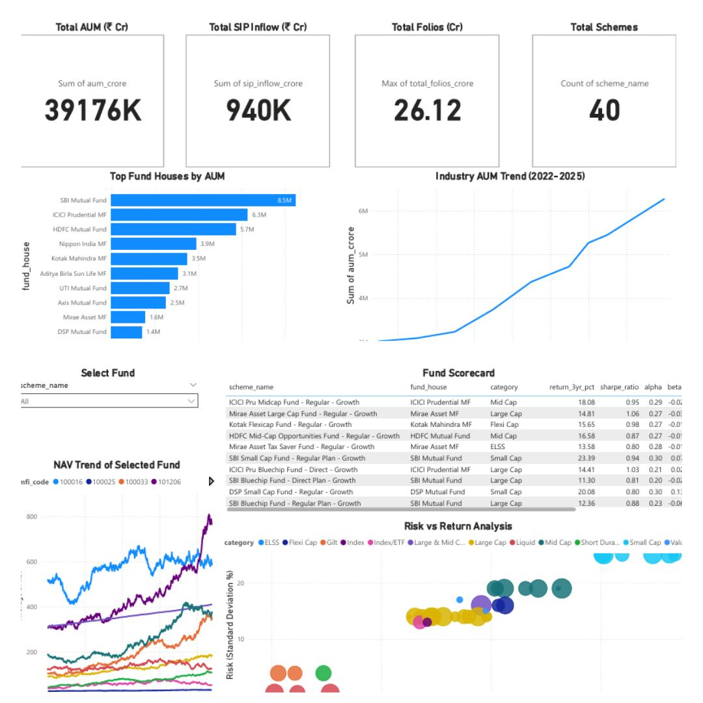

BI Dashboard Overview
The interactive Power BI dashboard serves as the central hub for our insights, seamlessly connecting the backend SQL database to front-end visual analytics.
Primary KPIs Tracked
•
Total AUM: Industry-wide asset growth tracking
•
Total SIP Inflow: Monthly retail investment monitoring
•
Fund Performance: NAV trend and scorecard analysis.
•
Risk vs Return: Risk-adjusted fund comparison

Slide 9
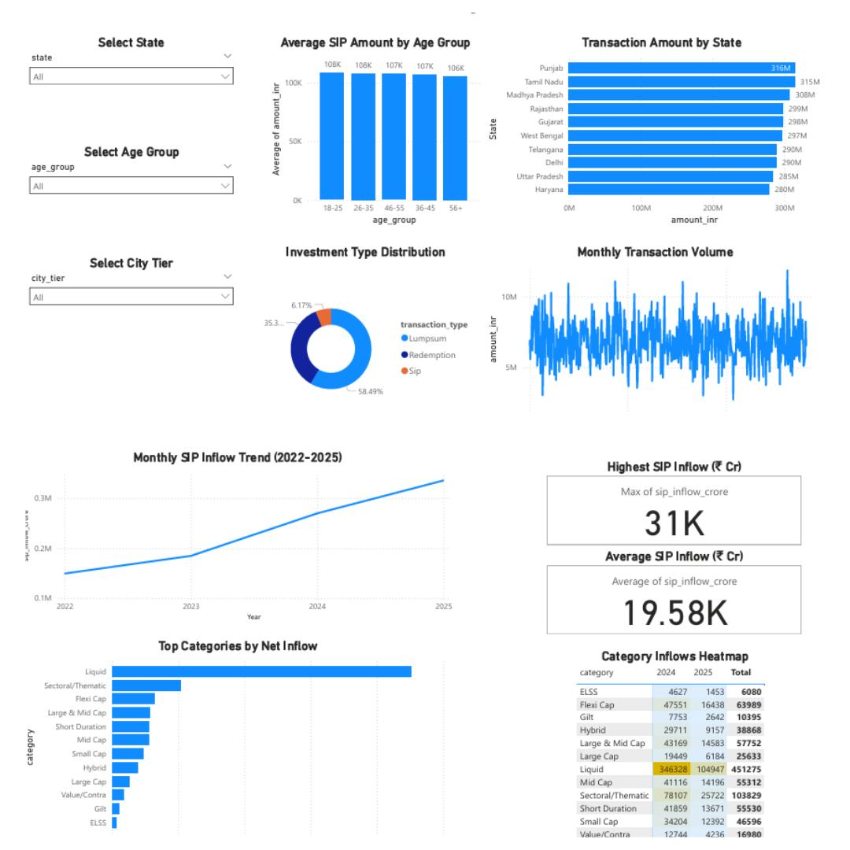
Investor Analytics Dashboard
Key Investor Insights
Investor activity was analyzed across age groups and city tiers.
State-wise transaction patterns highlighted regional investment concentration.
SIP transactions represented the dominant recurring investment mode.
Monthly transaction volume showed consistent participation throughout the analysis period.

Slide 10
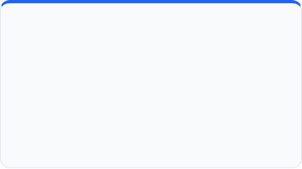


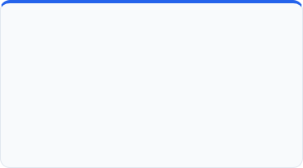
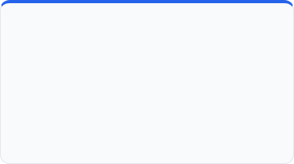

Advanced Analytics & Modeling
VaR & CVaR
Rolling Sharpe Ratio
Cohort Analysis
Modeled downside risk using historical fund returns.
Tracked rolling Sharpe ratios to evaluate consistency of risk-adjusted performance over time.
Grouped investors by onboarding month to track long-term portfolio growth and retention behavior.
SIP Continuity
Sector HHI Analysis
Recommendation Engine
Identified investors at risk of SIP discontinuation using transaction frequency and average gap analysis.
Utilized Herfindahl-Hirschman Index to measure portfolio concentration and sector diversification risks.
Built logic to map investor risk profiles to suitable mutual fund recommendations using historical fund performance data.

Slide 11

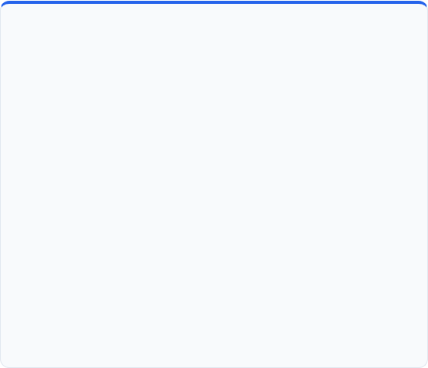




Key Findings & Strategic Recommendations
Key Findings
Targeted Recommendations
Sustained AUM Growth: The industry shows robust compounded growth despite short-term volatility.
Data-driven portfolio alignment based on investor profiles:
Low Risk Appetite
SIP Dominance: SIP transactions represented the dominant recurring investment mode across investors.
Moderate Risk Appetite
Risk Adjustments Matter: Several high-return funds failed on risk metrics (high Max Drawdown).
High Risk Appetite
Diversification pays off: Lower Sector HHI values indicated better portfolio diversification and reduced concentration risk.

Slide 12







Thank You!
Transforming Mutual Fund Data into Actionable Investment Insights
Core Skills Demonstrated:
sumit77185@gmail.com
https://github.com/sumit123-tech/bluestock-mf-capstone

